Slide 1
UE23CS320B– Project Phase – 2
Capstone Project –Phase 2 –review 1
Project Title : AI-Based Dog Health Monitoring System Using Dual-Input (Images + Symptoms)
Project ID :193
Project Guide : Prof. Umme Haani
Project Team : Aishwarya Ravi – PES2UG23AM008
Deepika N – PES2UG23AM028
Rahul Rathod – PES2UG23CS462
Renuka Gangadhar Hosamani - PES2UG23CS474

Slide 2
Agenda
Problem Statement
Abstract and Scope
Suggestions from Phase-1
Requirements Specification
Data set and requirements
Design Approach
Design Constraints, Assumptions & Dependencies
Proposed System / Approach
Architecture
Design Description
Project Progress
References

Slide 3
Problem Statement
Pet owners often struggle to identify whether their pets are suffering from common or serious illnesses. Visiting a veterinarian for every minor concern can be costly and inconvenient. Many diseases show early signs in the form of symptoms (loss of appetite, vomiting, fatigue) and visible indicators (abnormal stool, urine color, skin conditions, or vomit appearance). There is currently no widely available system that integrates both symptom descriptions and visual evidence to support early health assessments. We aim to develop a hybrid, multi-modal AI system that analyzes both symptom descriptions and pet images to predict possible diseases, highlight key evidence, and guide owners on whether they should seek veterinary care.

Slide 4
Abstract
This project addresses the problem of inaccurate or delayed disease detection in dogs caused by single-input health monitoring systems. It introduces an AI-Based Dog Health Monitoring System that uses dual inputs — images and symptoms for better accuracy. The system applies deep learning for image-based disease detection and machine learning for symptom analysis. By integrating both data types, it ensures early and more reliable diagnosis among breeds. The project aims to assist veterinarians and pet owners in improving preventive healthcare and timely treatment.

Slide 5
Scope
The scope includes data collection, preprocessing, model training, and multimodal fusion of images and symptoms. It covers health monitoring and disease prediction for different dog breed sizes with scalable AI models. The system provides a user-friendly interface for owners to upload images and report symptoms for instant analysis. Future extensions can integrate IoT sensors for real-time health tracking. Overall, the project establishes a foundation for AI-driven, breed-aware, and multimodal veterinary health monitoring systems.

Slide 6
Suggestions from Phase-1
During Phase–1 review, the panel suggested integrating IOT sensors for continuous health monitoring. After evaluation, it was found that IOT sensors increase cost and hardware dependency, reducing accessibility for users. Hence, the current system focuses on a user-friendly, software-based approach using images and symptom descriptions. Optional inputs such as age and temperature are included to add contextual health information. The system remains scalable, allowing IOT sensor integration as a future enhancement.

Slide 7
Requirements Specification
Functional Requirements
Upload pet image
Enter symptoms
Select breed category
Generate disease prediction
Classify severity
Display home care suggestion
Show nearby veterinary clinics
Allow appointment booking request

Slide 8
Requirements Specification
Non-Functional Requirements
Response time < 5 seconds
Prediction accuracy > 80% (prototype goal)
Secure user data handling
Scalable architecture
User-friendly interface

Slide 9
Requirements Specification
Technologies Used
Python
TensorFlow / PyTorch (CNN)
Scikit-Learn (Random Forest / XGBoost)
Flask (Backend)
MySQL (Database)
HTML/CSS/Bootstrap (Frontend)

Slide 10
Data set and requirements
Image Dataset
Type:
Dog skin diseases
Eye infections
Wounds
Healthy samples
Features Extracted:
Redness detection
Fur loss patches
Lesion shape
Texture variation
Model Used : CNN-based image classifier
B. Symptom Dataset
Structured dataset format:
| Vomiting | Fever | Itching | Duration | Disease Label |
Features Considered:
Vomiting
Diarrhea
Lethargy
Loss of appetite
Fever
Itching
Model Used: Random Forest / XGBoost

Slide 11
Data set and requirements
C. Severity Features
Derived using:
Symptom frequency
Duration
Image confidence score
Severity Output:
Mild
Moderate
Severe

Slide 12
Design Approach
We followed a Modular Multimodal Architecture with Late Fusion Approach.
The system is divided into two independent modules:
Image Processing Module (CNN)
Symptom Analysis Module (ML Model)
The outputs of both modules are combined using a fusion layer to generate the final health prediction.

Slide 13
Design Approach
Why this approach?
Allows independent development and testing of each module.
Improves accuracy by combining visual and symptom-based features.
Suitable for prototype development within limited time.
Easy to scale and extend in future

Slide 14
Design Approach
Benefits of this Approach
Better accuracy compared to single-input systems.
Clear separation of components (modular design).
Easier debugging and model improvement.
Scalable for adding more breeds or diseases.
Flexible — one module can work even if the other input is missing.

Slide 15
Design Approach
Drawbacks (Limitations)
Requires separate dataset preparation for images and symptoms.
Fusion logic increases system complexity.
Performance depends heavily on dataset quality.
May require more training time.

Slide 16
Design Approach
Alternate Design Approaches
Single Input System
Only image-based or only symptom-based.
Simpler but less accurate.
Early Fusion Approach
Combine image and symptom features before classification.
More complex and requires aligned multimodal datasets.
Rule-Based Expert System
Predefined symptom rules.
Less flexible and not scalable.

Slide 17
Design Constraints, Assumptions & Dependencies
Design Constraints
Limited availability of multimodal datasets containing both image and symptom data together.
Variations across different dog breeds (size, coat type, disease patterns) increase model complexity.
Limited computational resources and absence of high-end GPUs for large-scale training.
Prototype-level implementation without full clinical validation.

Slide 18
Design Constraints, Assumptions & Dependencies
Assumptions
Uploaded dog images are clear and properly visible.
Users provide basic and correct symptom information.
Selected breeds effectively represent small, medium, and large categories.
Public datasets are sufficiently labeled and reliable.
System output is intended only for preliminary health assessment.

Slide 19
Design Constraints, Assumptions & Dependencies
Dependencies
Availability and quality of public datasets from Kaggle, Roboflow, and Stanford Dogs.
Performance of CNN for image-based analysis.
Proper preprocessing and encoding of symptom data.
Successful integration of image and symptom models.
Regular guidance and feedback from project mentor.

Slide 20
Design Details
Design Details
The system is developed using a modular multimodal design, processing dog images and symptoms separately and combining them for final prediction.
Publicly available datasets are used, and the system runs on a local development environment.
The design is innovative as it integrates visual and symptom-based analysis instead of relying on a single input.
A modular structure ensures maintainability, reusability, and easy future extension.
The system is portable and compatible with standard platforms and can be extended to web or mobile applications.

Slide 21
Proposed System / Approach
System Overview
Multimodal AI-based system for dog skin disease classification
Uses dual inputs:
Dog skin image
Symptom text description
Optional contextual inputs:
Age
Temperature
Combines deep learning and machine learning using a late fusion strategy
Designed to improve prediction accuracy and reliability

Slide 22
Proposed System / Approach
Data Acquisition & Inputs
Collects dog skin images across six disease categories
Accepts symptom descriptions from pet owners
Optional metadata: age and body temperature
Uses publicly available datasets and user-provided inputs
Acts as the entry layer of the system

Slide 23
Proposed System / Approach
Image & Text Processing Modules
Image Processing Module
Images resized to 224 × 224
Normalization and data augmentation applied
Pretrained ResNet-18 used for feature extraction
Outputs disease probability scores
Text Processing Module
Symptom text cleaned and tokenized
TF-IDF converts text to numerical features
Random Forest classifier predicts disease probabilities

Slide 24
Proposed System / Approach
Late Fusion Strategy
Uses decision-level (late) fusion
Image-based and text-based predictions generated independently
Optional age and temperature refine predictions
Weighted fusion combines outputs from both models
Improves robustness and reduces misclassification

Slide 25
Proposed System / Approach
Output & Key Features
Final output includes:
Disease category
Confidence score
Risk level
Suggested action and veterinary advice
Key features:
Multimodal input (Image + Text)
Modular and scalable design
Optional contextual refinement
Focus on early-stage skin disease detection

Slide 26
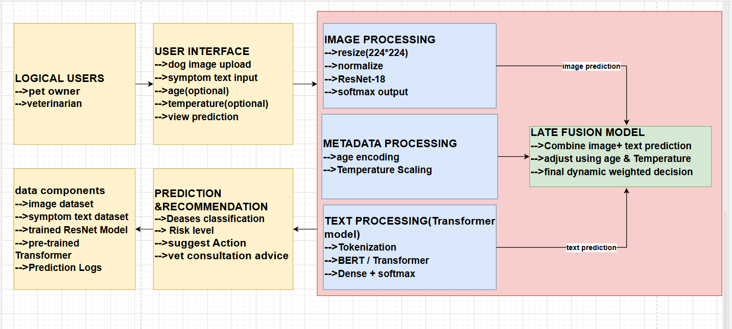
Architecture

Slide 27
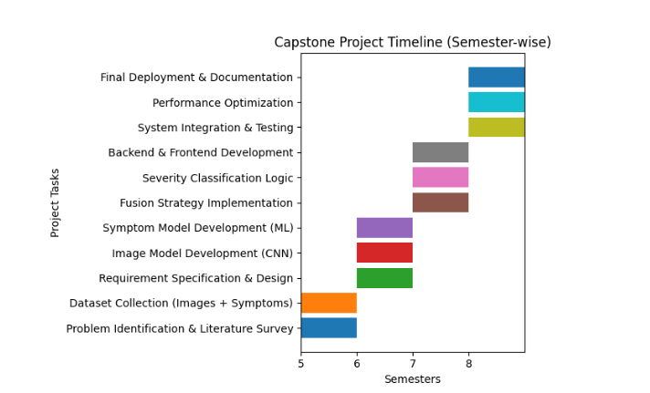
Capstone (Phase-I ,Phase-II and phase -III) Project Timeline

Slide 28
Conclusion
CONCLUSION
Designed a multimodal AI-based pet health assistance system.
Integrated severity prediction.
Added actionable home-care guidance.
Implemented vet recommendation module.
Built scalable modular architecture.
This system bridges the gap between AI prediction and practical veterinary assistance.

Slide 29
References
📚 References (IEEE Format)
1) L. Chen, M. Zhao, and Y. Li, “A Multimodal Fusion Approach for Veterinary Disease Detection,” Computers in Biology and Medicine, vol. 169, pp. 107534, 2024.
2) A. Kumar, R. Sharma, and S. Gupta, “Deep Learning-Based Pet Disease Diagnosis Using Skin and Fur Images,” IEEE Access, vol. 11, pp. 45782–45791, 2023.

Slide 30
Thank You

